Slide 1
Counting
Chapter 6

Slide 2
The Basics of Counting
Section 6.1

Slide 3
Counting
How many different passwords exist?
How many outcomes does an experiment have?
How many steps an algorithm performs?
How many moves are possible in a game?
Counting is ubiquitous in computer science and mathematics

Slide 4
Video 61: The Product Rule
Product Rule
Applications of the Product Rule

Slide 5
Basic Counting Principles: The Product Rule
The Product Rule: Assume there are two tasks A and B. There are n₁ ways to do A and n₂ ways to do B. Then there are n₁ ∙ n₂ ways to do both tasks.
Example: How many pairs of dices can be rolled?
Since each dice has 6 faces, we can roll 6 * 6 = 36 pairs

Slide 6
Example
How many different license plates can be made if each plate contains a sequence of two uppercase letters followed by five digits?
By the product rule, there are 26 ∙ 26 ∙ 10 ∙ 10 ∙ 10 ∙ 10 ∙ 10 = 67’600’000 different possible license plates.

Slide 7
Counting Functions
How many functions are there from a set with m elements to a set with n elements?
Since a function represents a choice of one of the n elements of the codomain for each of the m elements in the domain, the product rule tells us that there are n ∙ n ∙ … ∙ n = n^{m} such functions.

Slide 8
Counting One-to-one Functions
How many one-to-one functions are there from a set with m elements to one with n elements?
Suppose the elements in the domain are a₁, a₂,…, a_{m}.
There are n ways to choose the value of a₁, n−1 ways to choose a₂, etc.
The product rule tells us that there are n ∙ (n−1) ∙ (n−2) ∙ … ∙ (n−m +1) such functions.

Slide 9
Counting Subsets of a Finite Set
Use the product rule to show that the number of different subsets of a finite set S is 2^{|S|}.
Proof:
When the elements of S are listed in an arbitrary order, there is a one-to-one correspondence between subsets of S and bit strings of length |S|.
When the i^{th} element is in the subset, the bit string has a 1 in the i^{th} position and a 0 otherwise.
By the product rule, there are 2^{|S|} such bit strings, and therefore 2^{|S|} subsets. ◀︎

Slide 10
Counting Cartesian Products
If A₁, A₂, … , A_{m} are finite sets, then the number of elements in the Cartesian product of these sets is the product of the number of elements of each set.
Proof:
The task of choosing an element in the Cartesian product A₁ ⨉ A₂ ⨉ ∙∙∙ ⨉ A_{m} is done by choosing an element in A₁, then an element in A₂ , …, and finally an element in A_{m}.
By the product rule, it follows that: |A₁ ⨉ A₂ ⨉ ∙∙∙ ⨉ A_{m} |= |A₁| ∙ |A₂| ∙ ∙∙∙ ∙ |A_{m}|. ◀︎

Slide 11
Summary
Product Rule
Applications of the Product Rule
Counting functions
Counting subsets
Counting tuples

Slide 12
Video 62: The Sum Rule
Sum Rule
Subtraction Rule

Slide 13
Basic Counting Principles: The Sum Rule
The Sum Rule: Assume there are two tasks A and B. There are n₁ ways to do A and n₂ ways to do B and none of the set of n₁ ways is the same as any of the set of n₂ ways. Then there are n₁ + n₂ ways to do task A or B.
Example: A student can choose a semester project from one of three laboratories. The three laboratories offer 5, 3, and 7 possible projects, respectively. No project is offered by several laboratories. How many possible projects are there to choose from?
By the sum rule it follows that there are 5+3+7 = 15 ways to choose a project.

Slide 14
The Sum Rule in Terms of Sets
The sum rule can be phrased as
|A ∪ B|= |A| + |B| as long as A and B are disjoint sets.
or more generally, |A₁ ∪ A₂ ∪ ∙∙∙ ∪ A_{m} |= |A₁| + |A₂| + ∙∙∙ + |A_{m}| when A_{i} ∩ A_{j} = ∅ for all i, j.
The case where the sets have elements in common is different!

Slide 15
Combining the Sum and Product Rule
Example: Suppose variable names in a programming language can be either a single letter or a letter followed by a digit. Find the number of possible names.
Use the product rule.
26 + 26 ∙ 10 = 286

Slide 16
Counting Passwords
Each user on a computer system has a password, which is six to eight characters long, where each character is an uppercase letter or a digit. Each password must contain at least one digit.
How many possible passwords are there?
Let P be the total number of passwords, and let P₆, P₇, and P₈ be the passwords of length 6, 7, and 8.
By the sum rule P = P₆ + P₇ + P₈.
To find each of P₆, P₇, and P₈, we find the number of passwords of the specified length composed of letters and digits and subtract the number composed only of letters
P₆ = 36⁶ − 26⁶
P₇ = 36⁷ − 26⁷
P₈ = 36⁸ − 26⁸
Consequently, P = P₆ + P₇ + P₈ = (36⁶ − 26⁶) + (36⁷ − 26⁷) + (36⁸ − 26⁸) = 2,684,483,063,360

Slide 17
Basic Counting Principles: Subtraction Rule
Subtraction Rule: If a task can be done either in one of n₁ ways or in one of n₂ ways, then the total number of ways to do the task is n₁ + n₂ minus the number of ways to do the task that are common to the two different ways.
Also known as, the principle of inclusion-exclusion:

Slide 18
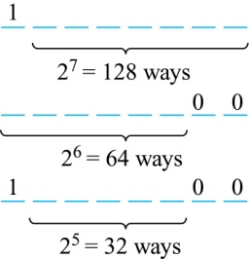
Counting Bit Strings
How many bit strings of length eight either start with a 1 bit or end with the two bits 00?
Use the principle of inclusion-exclusion.
Number of bit strings of length eight that start with a 1 bit: 2⁷ = 128
Number of bit strings of length eight that end with bits 00: 2⁶ = 64
Number of bit strings of length eight that start with a 1 bit and end with bits 00 : 2⁵ = 32
Hence, the number is 128 + 64 − 32 = 160.

Slide 19
Summary
Sum Rule
Subtraction Rule
Applications to counting strings

Slide 20
The Pigeonhole Principle
Section 6.2

Slide 21
Video 63: The Pigeonhole Principle
The Pigeonhole Principle
The Generalized Pigeonhole Principle

Slide 22
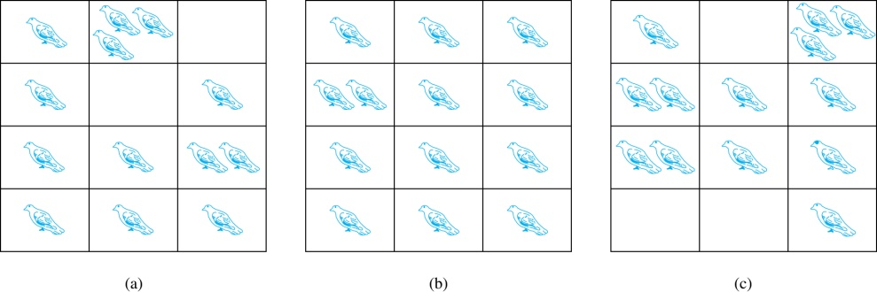
The Pigeonhole Principle
If a flock of 13 pigeons lives in a set of 12 pigeonholes, one of the pigeonholes must have more than 1 pigeon.

Slide 23
The Pigeonhole Principle
Pigeonhole Principle: If k is a positive integer and k + 1 objects are placed into k boxes, then at least one box contains two or more objects.
Proof: We use a proof by contraposition.
Suppose none of the k boxes has more than one object.
Then the total number of objects would be at most k.
This contradicts the assumption that we have k + 1 objects. ◀︎

Slide 24
Using the Pigeonhole Principle
Corollary: A function f from a set with k + 1 elements to a set with k elements is not one-to-one.
Proof: Use the pigeonhole principle.
Create a box for each element y in the codomain of f .
Put in the box for y all of the elements x from the domain such that f(x) = y.
Because there are k + 1 elements and only k boxes, at least one box has two or more elements.
Hence, f can’t be one-to-one. ◀︎

Slide 25
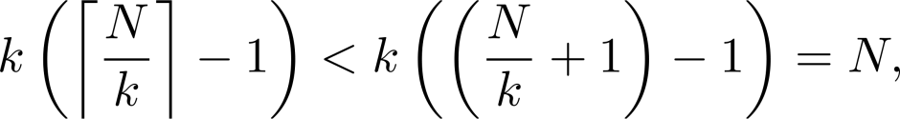
The Generalized Pigeonhole Principle
The Generalized Pigeonhole Principle: If N objects are placed into k boxes, then there is at least one box containing at least ⌈N/k⌉ objects.
Proof: We use a proof by contraposition.
Suppose that none of the boxes contains more than ⌈N/k⌉ − 1 objects.
Since ⌈N/k⌉ < N/k + 1, the total number of objects is at most
This is a contradiction because there are a total of N objects . ◀︎

Slide 26
Example
Among 100 people there are at least ⌈100/12⌉ = 9 who were born in the same month.

Slide 27
Example
How many cards must be selected from a standard deck of 52 cards to guarantee that at least three cards of the same suit are chosen?
We assume four boxes; one for each suit.
Using the generalized pigeonhole principle, at least one box contains at least ⌈N/4⌉ cards.
At least three cards of one suit are selected if ⌈N/4⌉ ≥ 3.
The smallest integer N such that ⌈N/4⌉ ≥ 3 is N = 2 ∙ 4 + 1 = 9.
The 4 suits of cards

Slide 28
Summary
The Pigeonhole Principle
Counting functions
The Generalized Pigeonhole Principle

Slide 29
Permutations and Combinations
Section 6.3

Slide 30
Video 64: Permutations and Combinations
Permutations
Combinations

Slide 31
Permutations
Definition: A permutation of a set of distinct objects is an ordered arrangement of these objects. An ordered arrangement of r elements of a set is called an r-permutation.
The number of r-permutations of a set with n elements is denoted by P(n, r).
Example: Let S = {1, 2, 3}.
The ordered arrangement 3,1,2 is a permutation of S.
The ordered arrangement 3,2 is a 2-permutation of S.

Slide 32
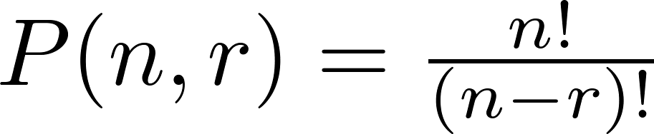
Counting the Number of Permutations
Theorem 1: If n is a positive integer and r is an integer with 1 ≤ r ≤ n, then there are
P(n, r) = n(n − 1)(n − 2) ∙∙∙ (n − r + 1)
r-permutations of a set with n distinct elements.
Proof: Use the product rule. The first element can be chosen in n ways. The second in n − 1 ways, and so on until there are (n − ( r − 1)) ways to choose the last element. Note that P(n, 0) = 1, since there is only one way to order zero elements. ◀︎
Corollary: If n and r are integers with 1 ≤ r ≤ n, then

Slide 33
Example
How many ways are there to select a first-prize winner, a second prize winner, and a third-prize winner from 100 different people who have entered a contest?
P(100,3) = 100 ∙ 99 ∙ 98 = 970,200

Slide 34
Example
How many permutations of the letters ABCDEFGH contain the string ABC ?
We count the permutations of six objects, ABC, D, E, F, G, and H.
6! = 6 ∙ 5 ∙ 4 ∙ 3 ∙ 2 ∙ 1 = 720

Slide 35
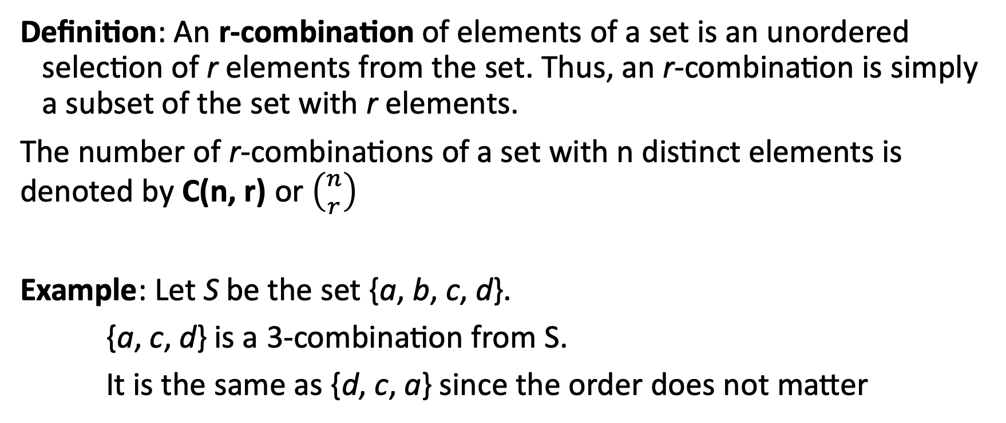
Combinations
Definition: An r-combination of elements of a set is an unordered selection of r elements from the set. Thus, an r-combination is simply a subset of the set with r elements.
The number of r-combinations of a set with n distinct elements is denoted by C(n, r) or $\left({n \atop r}\right)$
Example: Let S be the set {a, b, c, d}.
{a, c, d} is a 3-combination from S.
It is the same as {d, c, a} since the order does not matter

Slide 36
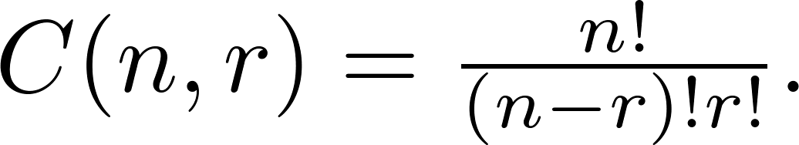
Counting Combinations
Theorem 2: The number of r-combinations of a set with n elements, where n ≥ r ≥ 0, equals
Proof: By the product rule P(n, r) = C(n,r) ∙ P(r,r). Therefore,
◀︎

Slide 37
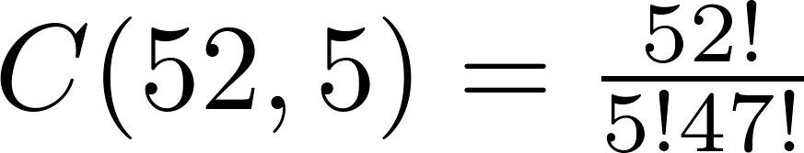
Example
How many poker hands of five cards can be dealt from a standard deck of 52 cards?
Since the order in which the cards are dealt does not matter, the number of five card hands is:
How many ways are there to select 47 cards from a deck of 52 cards?
The number of different ways to select 47 cards from 52 is

Slide 38
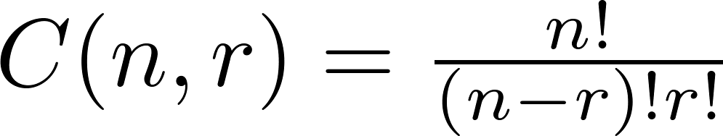
Combinations
Corollary: Let n and r be nonnegative integers with r ≤ n. Then C(n, r) = C(n, n − r).
Proof: From Theorem 2, it follows that
and
Hence, C(n, r) = C(n, n − r). ◀︎

Slide 39
Example: Full House
How many poker hands of five cards with a full house (three of a kind and a pair) can be dealt?
13 kind of cards to select the three, e.g. Aces
4 ways to select three Aces (we have to skip one color)
12 kind of cards left for the pair
6 ways to select two cards out of 4 – (1,2)(1,3)(1,4)(2,3)(2,4)(3,4)
So in total 13 · 4 · 12 · 6 = 3744 ways to select a full house

Slide 40

Summary
Permutations n!
Combinations $\left({n \atop r}\right)$

Slide 41
Binomial Coefficients and Identities
Section 6.4

Slide 42
Video 65: The Binomial Theorem
The Binomial Theorem
Pascal’s Identity and Triangle

Slide 43
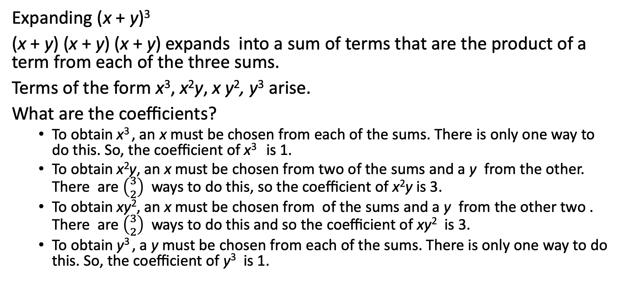
Example
Expanding (x + y)³
(x + y) (x + y) (x + y) expands into a sum of terms that are the product of a term from each of the three sums.
Terms of the form x³, x²y, x y², y³ arise.
What are the coefficients?
To obtain x³ , an x must be chosen from each of the sums. There is only one way to do this. So, the coefficient of x³ is 1.
To obtain x²y, an x must be chosen from two of the sums and a y from the other. There are $\left({3 \atop 2}\right)$ ways to do this, so the coefficient of x²y is 3.
To obtain xy², an x must be chosen from of the sums and a y from the other two . There are $\left({3 \atop 2}\right)$ ways to do this and so the coefficient of xy² is 3.
To obtain y³ , a y must be chosen from each of the sums. There is only one way to do this. So, the coefficient of y³ is 1.

Slide 44
Binomial Theorem
Binomial Theorem: Let x and y be variables, and n a nonnegative integer. Then:
The coefficients of the expansion of the powers of (x+y) are thus related to the number of combinations

Slide 45
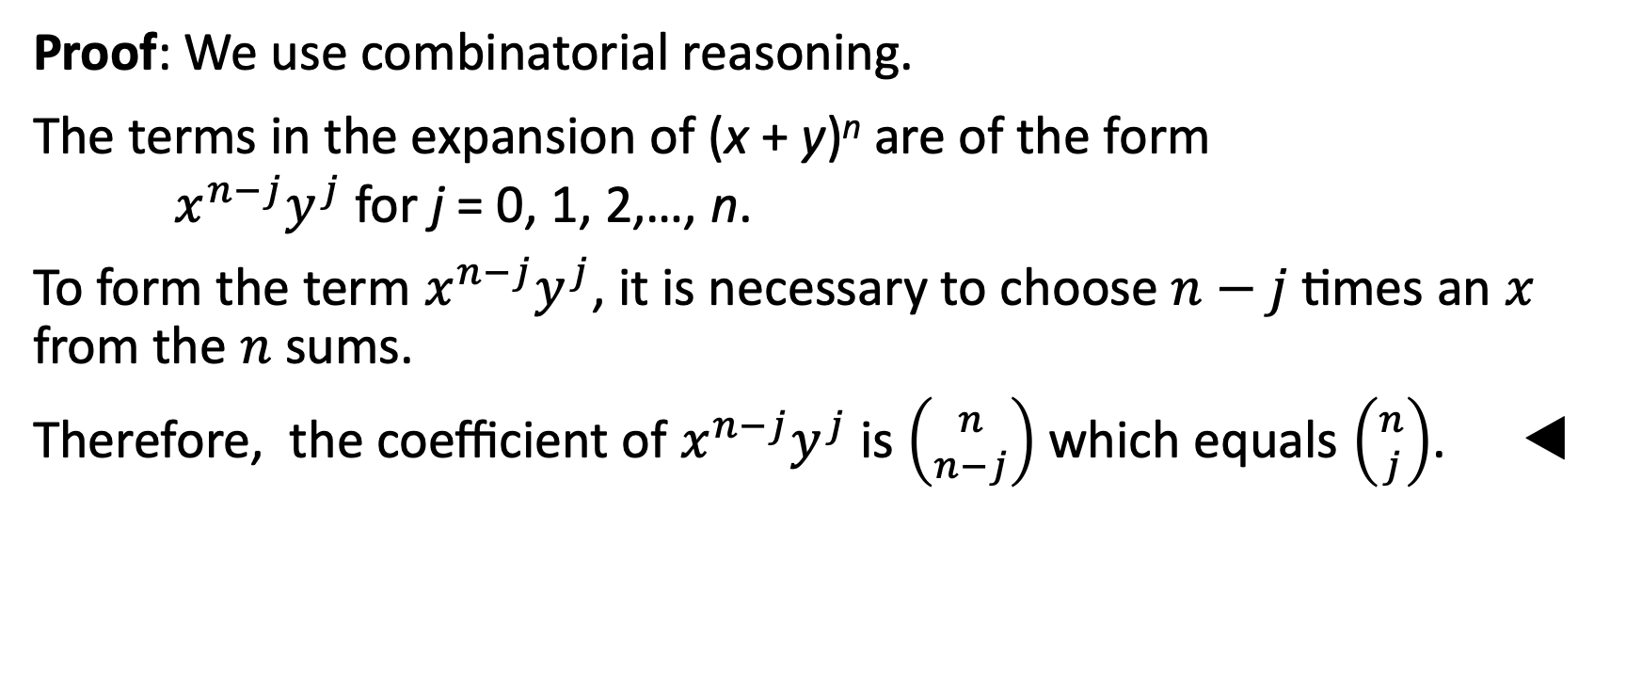
Proof of Binomial Theorem
Proof: We use combinatorial reasoning.
The terms in the expansion of (x + y)^{n} are of the form $x^{n−j}y^{j}$ for j = 0, 1, 2,…, n.
To form the term $x^{n−j}y^{j}$, it is necessary to choose $n−j$ times an $x$ from the $n$ sums.
Therefore, the coefficient of $x^{n−j}y^{j}$is $\left({n \atop n−j}\right)$ which equals $\left({n \atop j}\right)$. ◀︎

Slide 46
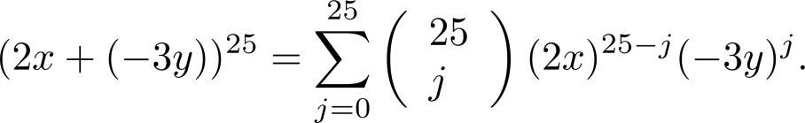
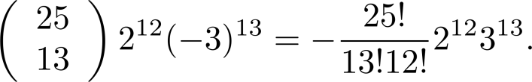
Using the Binomial Theorem
What is the coefficient of x¹²y¹³ in the expansion of (2x − 3y)²⁵?
Since (2x − 3y)²⁵ = ((2x) +(−3y))²⁵.
by the binomial theorem
Consequently, the coefficient of x¹²y¹³ in the expansion is obtained when j = 13.

Slide 47
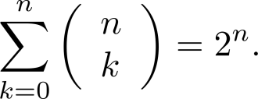
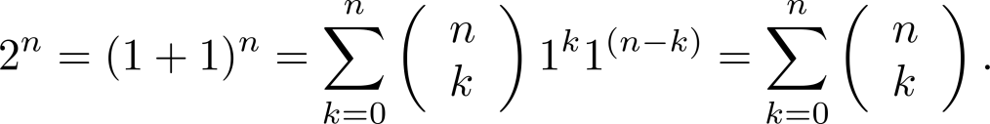
A Useful Identity
Corollary 1: With n ≥ 0,
Proof (using binomial theorem): With x = 1 and y = 1, from the binomial theorem we see that:

Slide 48
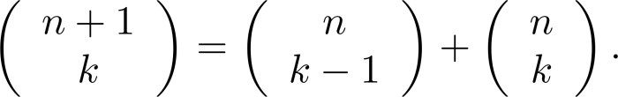
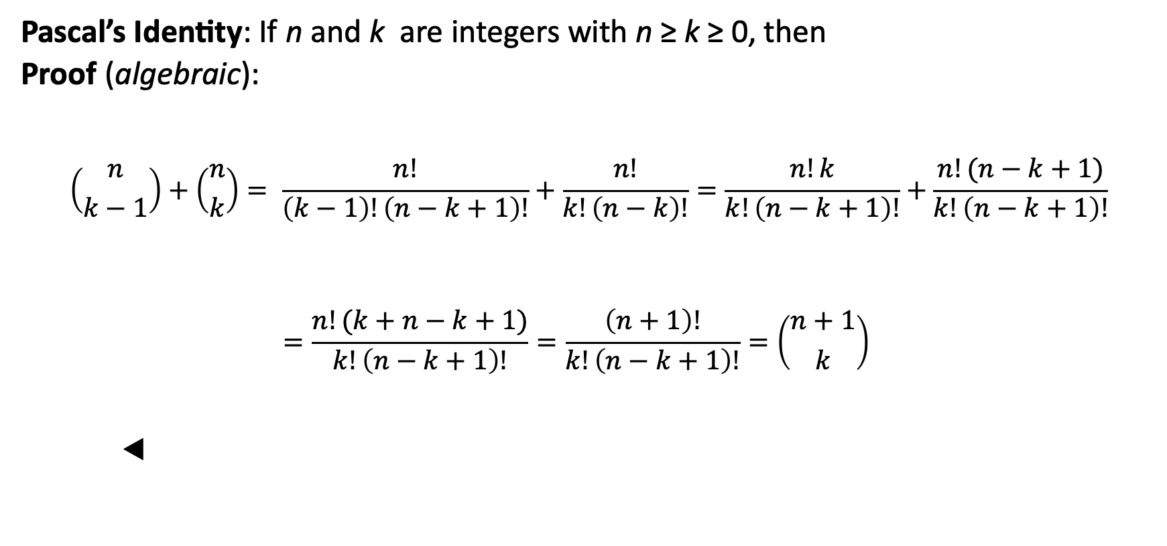
Pascal’s Identity
Pascal’s Identity: If n and k are integers with n ≥ k ≥ 0, then
Proof (algebraic):
$$\left({n \atop k−1}\right)+\left({n \atop k}\right)= \frac{n!}{\left(k−1\right)!\left(n−k+1\right)!}+\frac{n!}{k!\left(n−k\right)!}=\frac{n!k}{k!\left(n−k+1\right)!}+\frac{n!(n−k+1)}{k!\left(n−k+1\right)!}$$
$$=\frac{n!(k+n−k+1)}{k!\left(n−k+1\right)!}=\frac{\left(n+1\right)!}{k!\left(n−k+1\right)!}=\left({n+1 \atop k}\right)$$
◀︎

Slide 49
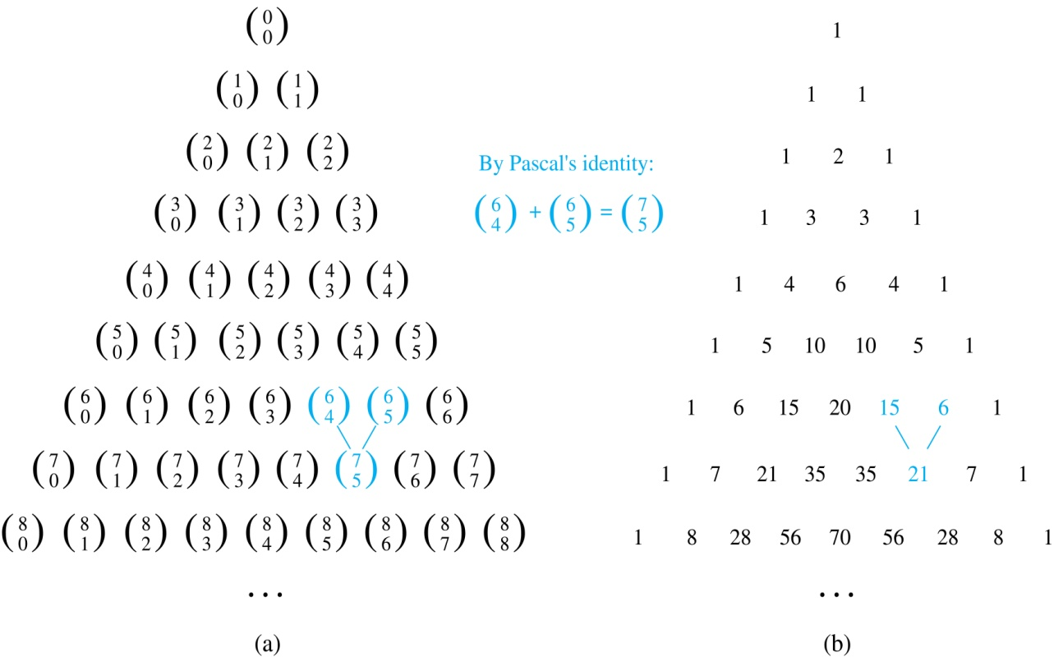
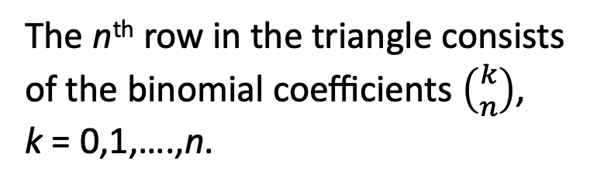
Pascal’s Triangle
The n^{th} row in the triangle consists of the binomial coefficients $\left({k \atop n}\right)$,
k = 0,1,….,n.
By Pascal’s identity, adding two adjacent binomial coefficients results is the binomial coefficient in the next row between these two coefficients.

Slide 50
Summary
The Binomial Theorem
Binomial expansion
Pascal’s Identity and Triangle

Slide 51
Generalized Permutations and Combinations
Section 6.5

Slide 52
Video 66: Counting with Repetitions
Permutations with Repetition
Combinations with Repetition
Permutations with Indistinguishable Objects

Slide 53
Permutations with Repetition
Definition: An r-permutation with repetition of a set of distinct objects is an ordered arrangement of r elements from the set, where elements can occur multiple times.
Theorem 3: The number of r-permutations of a set of n objects with repetition allowed is n^{r}.
Proof: There are n ways to select an element of the set for each of the r positions in the r-permutation when repetition is allowed.
Hence, by the product rule there are n^{r} r-permutations with repetition.
◀︎

Slide 54
Example
How many strings of length r can be formed from the uppercase letters of the English alphabet?
The number of such strings is 26^{r}, which is the number of r-permutations of a set with 26 elements.

Slide 55

r-combinations with Repetition
Definition: An r-combination with repetition of elements of a set is an unordered selection of r elements from the set, where elements can occur multiple times
Example: How many ways are there to select four pieces of apples, oranges, and pears if the order does not matter and the fruit are indistinguishable?

Slide 56
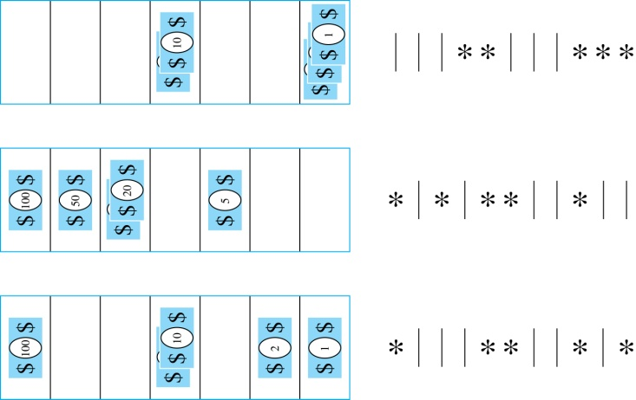

r-Combinations with Repetition
Example: How many ways are there to select five bills of the following denominations: $1, $2, $5, $10, $20, $50, and $100?
Place the selected bills in the appropriate position of a cash box as illustrated below:
Seven bills need six bars to separate six bars and five stars in a row
Putting the bills corresponds to selecting 5 stars from 11 possible positions
Therefore
possible ways to choose the bills

Slide 57
Combinations with Repetition
Theorem 4: The number of r-combinations from a set with n elements when repetition of elements is allowed is
C(n + r – 1, r) = C(n + r – 1, n –1).
Proof:
Each r-combination of a set with n elements with repetition allowed can be represented by a list of n –1 bars and r stars.
The bars mark the n cells containing a star for each time the i^{th} element of the set occurs in the combination.
The number of such lists is C(n + r – 1, r): each list is a choice of the r positions to place the stars, from the total of n + r – 1 positions to place the stars and the bars.
This is also equal to C(n + r – 1, n –1), which is the number of ways to place the n –1 bars. ◀︎

Slide 58
Example
How many solutions does the equation
x₁ + x₂ + x₃ = 11
have, where x₁ , x₂ and x₃ are nonnegative integers?
Each solution corresponds to a way to select 11 items from a set with three elements: x₁ elements of type one, x₂ of type two, and x₃ of type three.
By Theorem 4 it follows that there are
solutions.

Slide 59
Permutations with Indistinguishable Objects
Example: How many different strings can be made by reordering the letters of the word SUCCESS.
There are seven possible positions for the three Ss, two Cs, one U, and one E.
The three Ss can be placed in C(7, 3) different ways, leaving four positions free.
Then the two Cs can be placed in C(4, 2) different ways, leaving two positions free.
Then the U can be placed in C(2, 1) different ways, leaving one position free.
Then the E can be placed in C(1, 1) ways.
By the product rule, the number of different strings is:

Slide 60
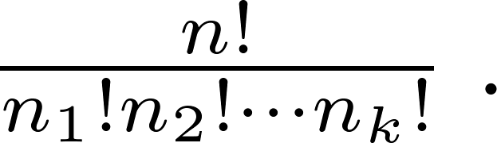
Permutations with Indistinguishable Objects
Theorem 5: The number of different permutations of n objects, where there are n₁ indistinguishable objects of type 1, n₂ indistinguishable objects of type 2, …., and n_{k} indistinguishable objects of type k, is:
Proof: By the product rule the total number of permutations is:
C(n, n₁ ) C(n − n₁, n₂ ) ∙∙∙ C(n − n₁ − n₂ − ∙∙∙ − n_{k}, n_{k}) since
The n₁ objects of type one can be placed in the n positions in C(n, n₁ ) ways, leaving n − n₁ positions.
Then the n₂ objects of type two can be placed in the n − n₁ positions in C(n − n₁, n₂ ) ways, leaving n − n₁ − n₂ positions.
This is repeated, until n_{k} objects of type k are placed in C(n − n₁ − n₂ − ∙∙∙ − n_{k}, n_{k}) ways.
Then
◀︎

Slide 61
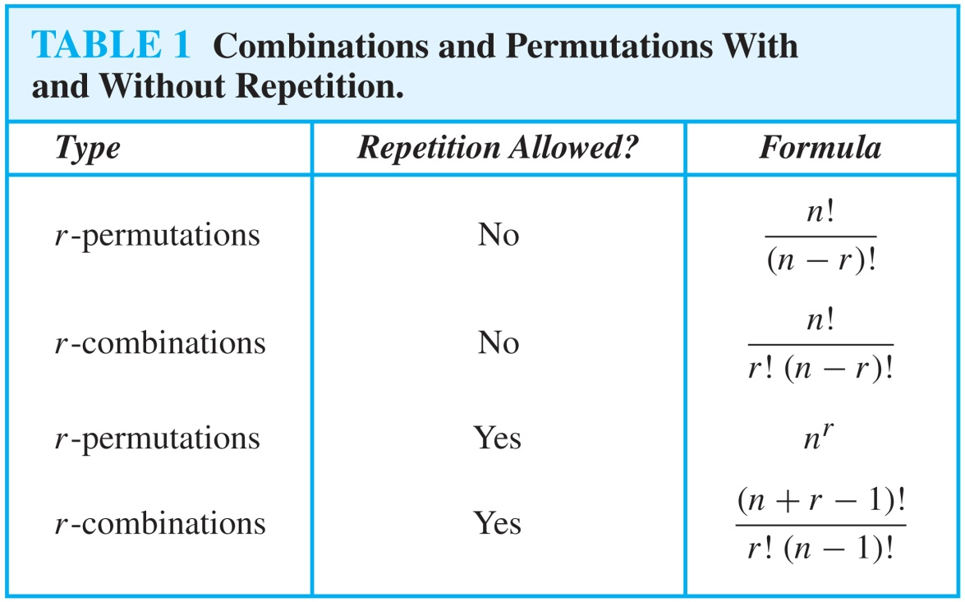
Summary: Permutations and Combinations

